Slide 1
HOOKS

Slide 2
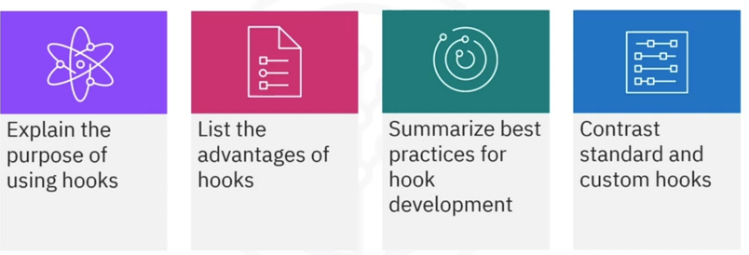
What you will learn

Slide 3
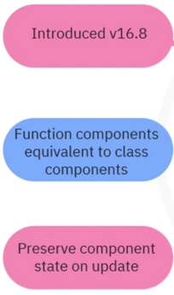
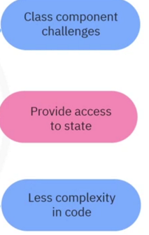

Introduction and Purpose

Slide 4
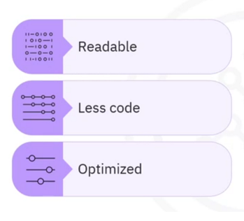
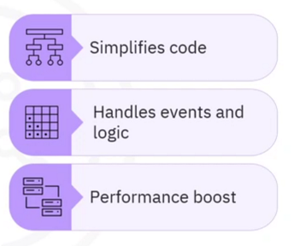
Advantages

Slide 5
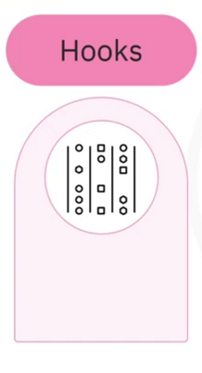
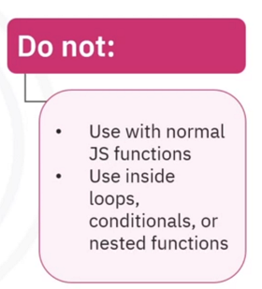
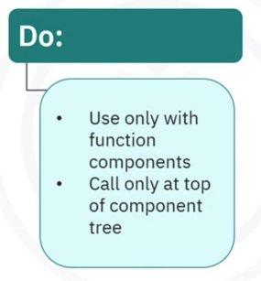
Best practices

Slide 6
For use with
Node.js v6 platform
Requires:
Set up the app with create-react app tool
NPM v5.2 or higher

Slide 7




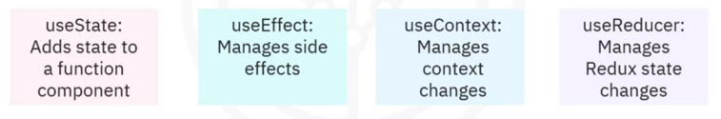
Common hooks

Slide 8
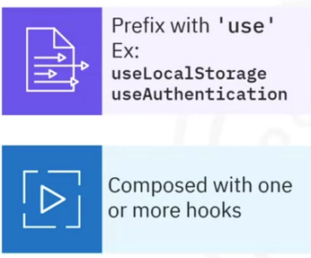
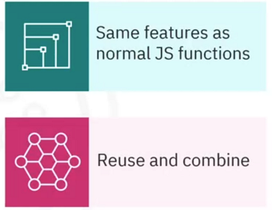
Writing custom hooks

Slide 9
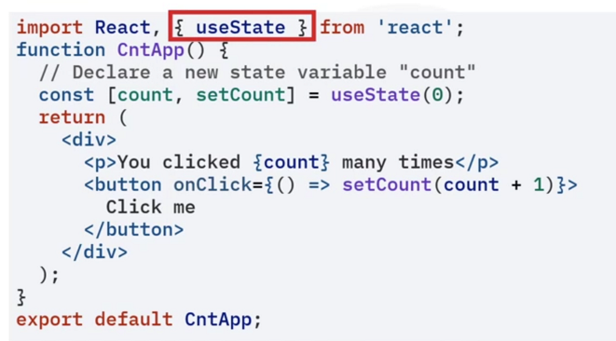
Example of hooks

Slide 10
Recap
In this video, you learned that:
• Hooks provide function components with the same capabilities as
class components
• Hooks enable you to write simpler, more readable, and a lesser
amount of code, providing more complex behaviors and improving
performance
• You must call hooks at the top of a tree and cannot call them from
regular or nested functions or inside Loops or conditions
• Standard hooks include use state, use effect, use context, and
use reducer
• And finally, you can add unique functionality using custom hooks

